Slide 1
AN EFFICIENT VOTE CASTING SYSTEM WITH AADHAR VERIFICATION THROUGH

Slide 2
Problem Statement
Problem Statement
Traditional voting systems often face challenges such as voter fraud, impersonation, booth capturing, and lack of transparency. Manual verification processes are time-consuming and error-prone. Additionally, centralized databases used for voter records are vulnerable to tampering and cyberattacks. There is a strong need for a secure, transparent, and verifiable digital voting solution that can authenticate voters reliably using Aadhaar and ensure data integrity through blockchain technology.
Problem Description
India’s voting process, while democratic, often suffers from inefficiencies such as duplicate voting, voter impersonation, and delayed results. Current electronic systems lack end-to-end transparency and verifiability. Aadhaar, being a widely used digital identity, offers a strong base for authentication but is not yet integrated with secure voting platforms. Without a tamper-proof and decentralized system, data breaches and trust issues persist. A solution is required that combines Aadhaar-based identity verification with the immutability and transparency of blockchain to ensure a fair, secure, and efficient election process.

Slide 3
Abstract
This project proposes a secure and transparent e-voting system that integrates Aadhaar-based voter authentication with blockchain technology to ensure a tamper-proof and verifiable voting process. By leveraging Aadhaar for digital identity verification and blockchain for immutable data recording, the system eliminates voter fraud, ensures only eligible voters participate, and maintains transparency throughout the election. Smart contracts automate and enforce voting rules, while decentralization removes reliance on a single authority, thereby enhancing trust, efficiency, and security in the democratic process.

Slide 4
Literature Survey
Aadhaar-Based Verification in E-Governance
Studies highlight the success of Aadhaar in delivering secure authentication for public services, but its use in voting remains limited due to concerns over privacy and integration.
Blockchain for Voting Systems
Research demonstrates that blockchain provides immutability, transparency, and security in digital voting platforms, preventing tampering and ensuring auditability.
Smart Contracts in E-Voting
Smart contracts have been explored to automate vote validation, enforce eligibility criteria, and ensure vote-count accuracy without manual interference.
Challenges in Traditional Voting
Existing literature points to issues such as fake voting, delayed results, and centralized control, making the case for decentralized digital voting systems.

Slide 5
Existing Systems
Electronic Voting Machines (EVMs)
Used widely in elections but are hardware-dependent, vulnerable to tampering, and lack voter-verifiable audit trails.
Online Voting Portals
Some countries use basic online voting systems, but many suffer from weak authentication, centralized data storage, and cybersecurity risks.
Aadhaar for Identity Verification
Used in various services for biometric-based authentication, but currently not integrated with secure e-voting platforms.
Blockchain-Based Prototypes
Initial blockchain voting prototypes exist but often lack integration with government-approved identity systems like Aadhaar in India.

Slide 6
Limitations
Centralized Data Vulnerability
Traditional systems store voting data in central servers, increasing the risk of tampering or cyberattacks.
Lack of Voter Transparency
Voters cannot independently verify if their vote was counted or altered, leading to trust issues.
Identity Fraud
Without strong digital authentication, there is a risk of duplicate or fraudulent voting.
Manual Oversight
Excessive human involvement in vote counting and verification may result in errors or bias.

Slide 7
Advantages
Secure Voter Authentication
Integration with Aadhaar ensures biometric-based identity verification, preventing impersonation and fake votes.
Tamper-Proof Voting Records
Blockchain technology provides immutable and transparent storage of each vote, ensuring data integrity.
End-to-End Transparency
Voters and authorities can verify the entire voting process, increasing public trust in election outcomes.
Reduced Human Intervention
Automated smart contracts handle vote validation and counting, minimizing manual errors and bias.

Slide 8
Proposed system/Innovation
Aadhaar-Based Voter Authentication
Utilizes Aadhaar-linked biometric or OTP verification to ensure only legitimate voters can cast their vote.
Blockchain-Powered Voting Ledger
Implements a decentralized, tamper-proof ledger to securely record every vote, ensuring transparency and integrity.
Smart Contract Automation
Deploys smart contracts to automatically validate, record, and count votes without human intervention.
End-to-End Verifiability
Each voter receives a unique, anonymous receipt to verify that their vote was recorded and counted accurately.
Remote Voting Capability
Enables secure online voting from anywhere, supporting higher voter participation including from remote or overseas locations.

Slide 9
USECASE DIAGRAM

Slide 10
CLASS DIAGRAM

Slide 11
SEQUENCE DIAGRAM

Slide 12
COLLABORATION DIAGRAM

Slide 13
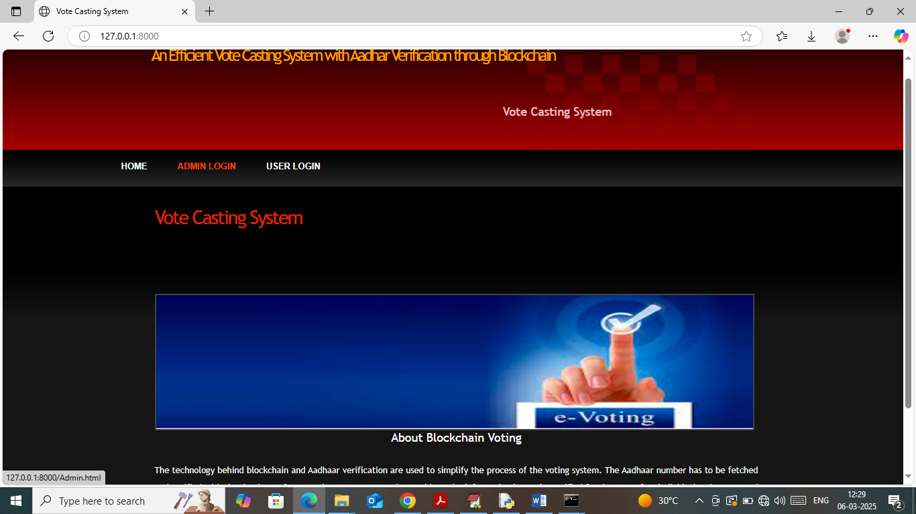
SCREENSHOTS

Slide 14
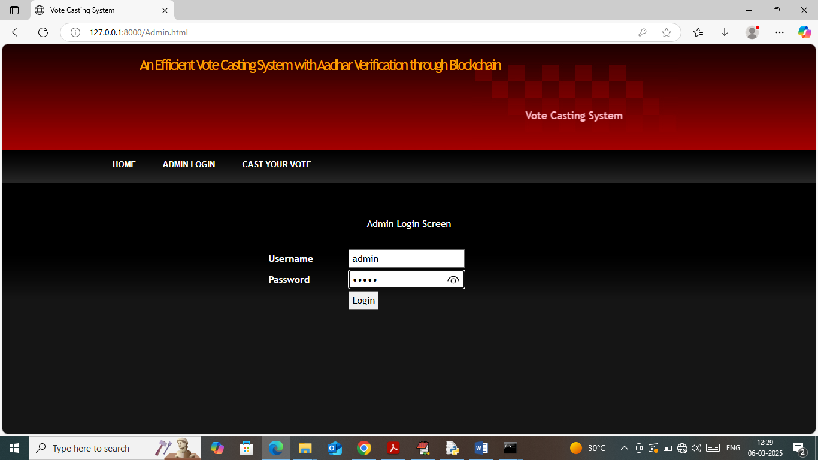

Slide 15
THANK YOU

